Slide 1

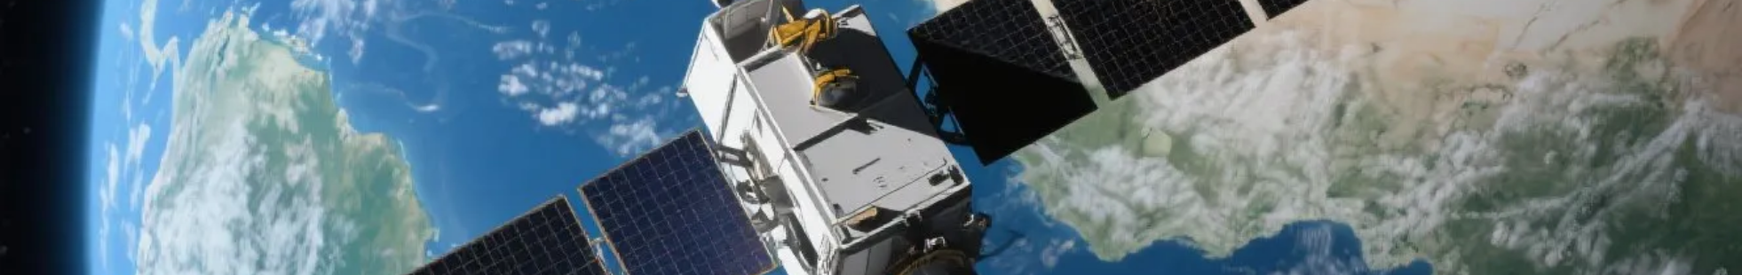

CHANDRASEKAR M
Author: Sekar M
Created with Pi

Slide 2

CONTENTS
1. Academic Information
2. Family Contacts
3. Skills & Languages
4. Interests
5. Projects

Slide 3


01
Academic Information

Slide 4


Education Background
10TH MARK
10TH STUDYING IN
11TH MARK
301
GHS PUNNAM ERODE (DT)
286
11TH STUDYING IN
12TH MARK
12TH STUDYING IN
GHSS GURUVARETYUR ERODE (DT)
290
GHSS GURUVARETYUR ERODE (DT)

Slide 5


Personal Information
Date of Birth
16/06/2007

Slide 6

02
Family Contacts

Slide 7







Family Contacts
1
2
3
Father
Phone
Mother
Madhappan M
+91 7695843727
Thangamani M
4
5
Email
Address
cs7086700@gmail.com
4/5-300, Milagoipothi, Kannamoochi, Salem DT, Kannamoochi PO

Slide 8

03
Skills & Languages

Slide 9





Skills & Languages
1
Skills
• HTML
• CSS
• JavaScript
2
Languages
• English
• Tamil

Slide 10

04
Interests

Slide 11
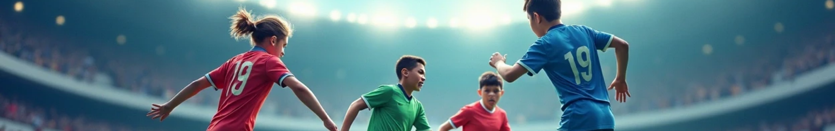
Interests
Sports

Slide 12
05
Projects

Slide 13

Projects
Portfolio Website
A responsive website built with HTML, CSS, and JavaScript.
Explore our developer-friendly HTML to PDF API.
Printed using PDFCrowd HTML to PDF.

Slide 14

Thank You

